Slide 1

Using R to Improve the COVID-19 Response at the Public Health Agency of Canada
2021-07-06
Farzad Islam, M.A. – Policy Analyst
Michael Elten, M.Sc – Epidemiologist
Najmus Saqib, M.A. – Data Scientist

Slide 2






Emergency Taskforce Assembled
ALL HANDS ON DECK!
Notes:
To effectively manage federal public health information needs during this pandemic, the agency needed to be meticulous in its surveillance of and reporting on COVID-19. Surveillance data was aggregated, analyzed and disseminated to meet these reporting needs. This was vital for policy makers and public health officials to make informed and timely decisions. Canada’s response has been lauded by the international community and we continue to take a leadership role. The Public Health Agency of Canada has been central to this response and we continue to serve our stakeholders, which include senior government officials, the Chief Public Health Officer, the media, as well as the general public.

Slide 3


The Initial Response
Around-the-clock surveillance established 7 days a week
New reporting measures established using SAS & Excel
Surveillance and reporting needs successfully met, but areas of improvement identified
Notes:
As a result of the extreme nature of the COVID-19 pandemic, the agency had to meet the need for timely reporting and around-the-clock surveillance 7 days a week. To do this, the emergency operations centre was activated and staffed using employees from across the agency on a rotation basis. These employees were responsible for setting up new reporting processes specific to the COVID-19 pandemic due to the unique nature of the disease. Initially, this was done primarily using SAS and Excel. While these tools were sufficient to address the information needs of the pandemic, some areas were identified for improvement as the agency’s COVID-19 response matured.

Slide 4
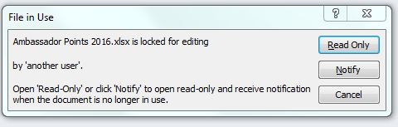



Areas for Improvement: File Access
…
…
Notes:
Source files for various metrics were often large Excel files stored on a network drive, and were rapidly increasing in size as the data was case-based, and COVID-19 case counts were increasing. Using SAS, these files were taking longer to access as file sizes increased. In addition, access was sometimes limited due to the fact that SAS would not be able to access the file if another user had the file open. Given the time-sensitive nature of reporting needs, this was the first area that was identified for improvement.

Slide 5
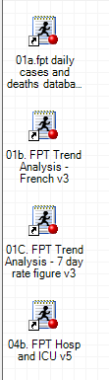
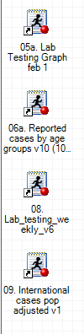
Areas for Improvement: Source Files
…
Notes:
To produce the necessary figures and graphics for each report, numerous SAS scripts were written. Each time a report had to be generated, each of these scripts had to be run separately. Depending on the report, this process could be time-consuming. In addition, portions of some code needed to be altered manually, including macro variables and file-paths. To ease the burden on the response team, this was another area that was identified for improvement.

Slide 6
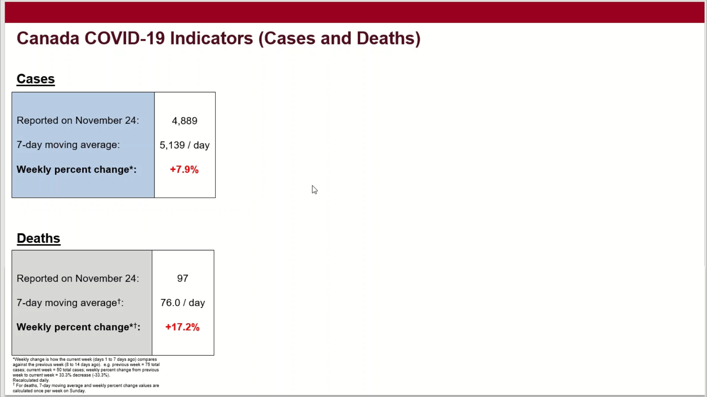
Issues with the Old Way (Copying and Pasting Images)
Notes:
Once produced, the plots generated by the SAS scripts had to be copied and manually pasted into a slide deck. This required careful placement onto slides, ensuring alignments were correct not only on each slide, but across slides.

Slide 7
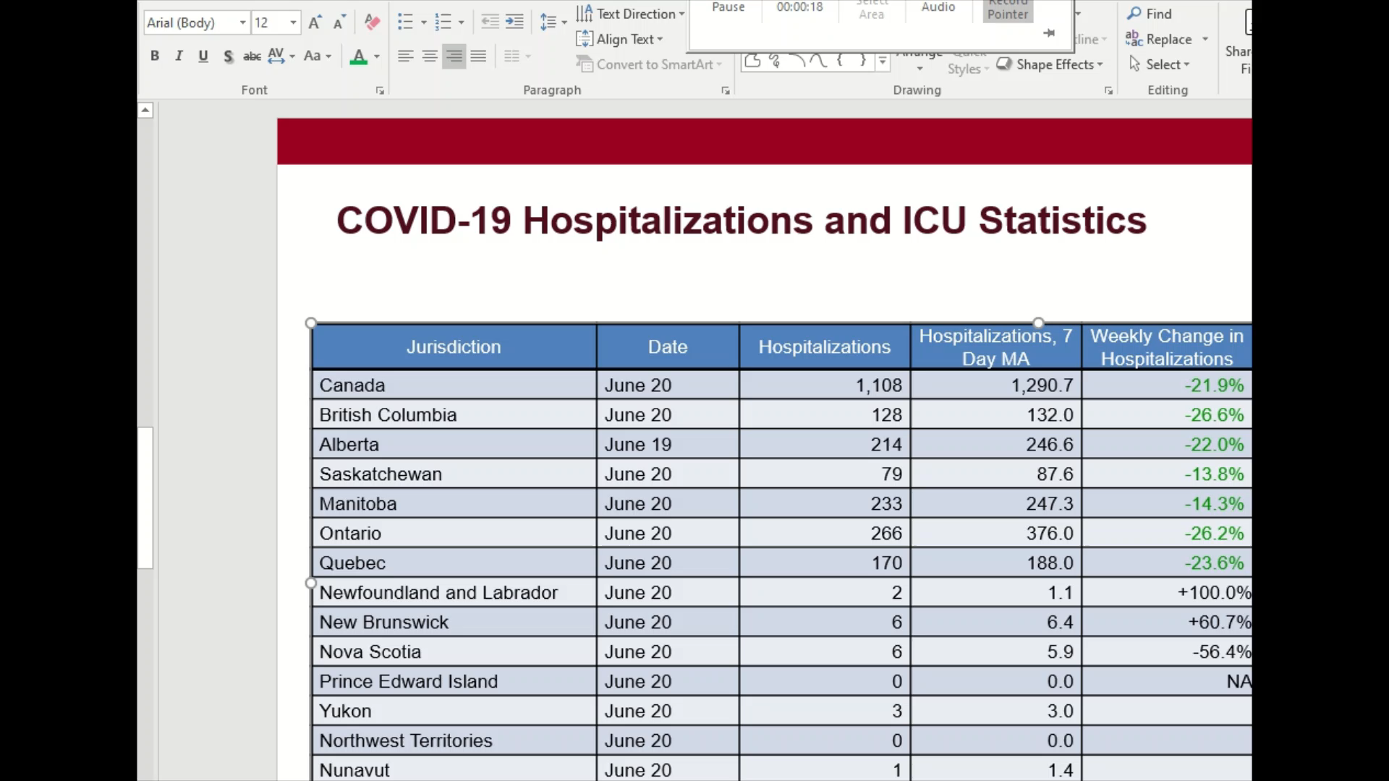
Issues with the Old Way (Filling in / Formatting Table)
Notes:
The tables in our reports were updated by manually entering figures produced by the SAS scripts. These figures had to also be formatted appropriately. This includes commas, decimals, percentage signs and font characteristics. For example, increasing case counts were manually formatted using red font, while a decrease was manually formatted to green. This was completed for each jurisdiction within Canada and for numerous metrics.

Slide 8
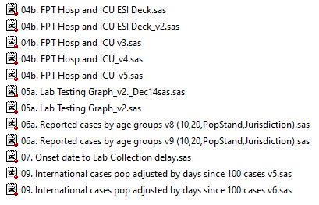

Areas for Improvement: Unifying Code and Improving Version Control
Notes:
Finally, due to the fact that different scripts existed for each report and had to be maintained separately, the potential to lessen the burden of this maintenance was identified by the team. For example, when manual corrections needed to be made to case data retroactively, this had to be done for each script for each report separately. The same is true for when formulas had to be updated. Furthermore, messy version control sometimes caused confusion for new team members trying to adapt when rotating into the team.

Slide 9

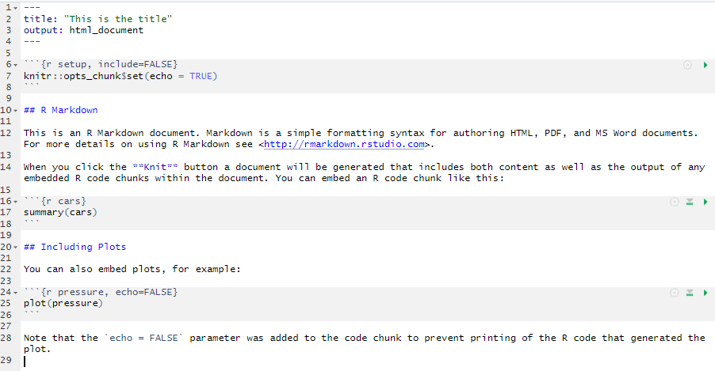
The Solution: Automating Reporting with R Markdown
YAML header
Defines output type, can provide global variables to the code chunks below
Text
Generates text, can use markup to apply formatting (ex. "#" character is used for headers)
Code chunk
Code from various engines (in this case, R) that will get processed and whose results are included in the output
Notes:
In order to make these improvements, the emergency response team made a shift to R. To address these areas of improvement, multiple packages in R were used to simplify, streamline and make more efficient our processes. The most important of these was R Markdown.
R Markdown is a powerful reporting tool that can output tables, objects, plots, and figures into a report with fixed formatting. This is done by running source codes in chunks and using a knitting feature that runs all the source codes and produces an output. The initial SAS codes were rewritten in R, moved to the back end and called upon using R Markdown. This has allowed us to automate and streamline our processes to the simple click of a button. There is no longer a need to run multiple codes separately. Reports are currently being produced using R Markdown in PowerPoint, and Docx.

Slide 10

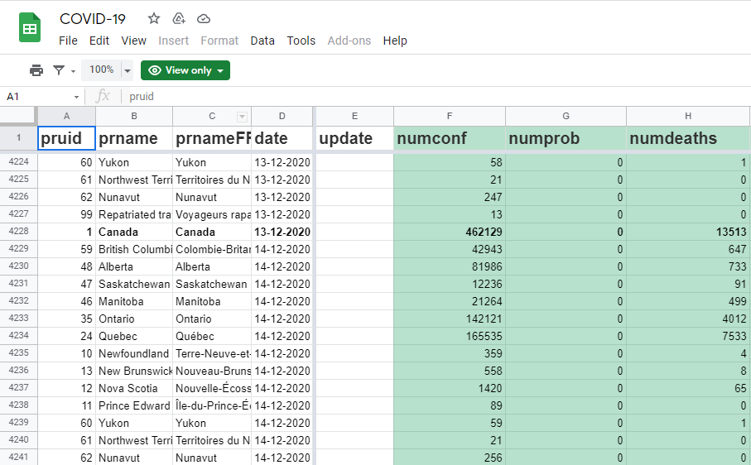
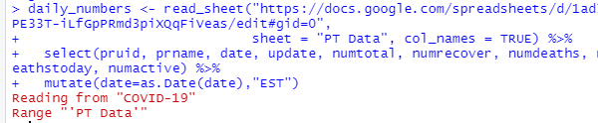
The Solution: Resolving Access Issues with the GoogleSheets4 Package
No access issues!
Faster processing!
Notes:
To improve the speed and ability with which we access files, the agency is now utilizing the GoogleSheets4 package in R. This allows us to access the datasets that were being stored in Excel on the network drive from a GoogleSheets file, which is an open-source web-based application. The data is now being retrieved with increased speed, and can be accessed regardless of how many people are using the data.

Slide 11

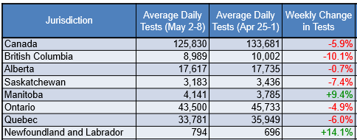
The Solution: Using the Flextable Package to Reduce Labour and Improve Accuracy
Detect and format date range for column title
Predetermine column width
Predetermine row height
Colour code metrics based on direction of change
Define number formatting (comma, percent, rounding), font type, font size, cell background, font colour, etc.
Notes:
To improve the way we utilize tables in our reports, we are using the Flextable package in R. With Flextable, entire dataframes are now being output into documents pre-formatted. Everything from dates, font colour, number formats, column and row width and height, as well as footnotes are now taken care of using this package. Even dynamic headers are created to incorporate dates.

Slide 12
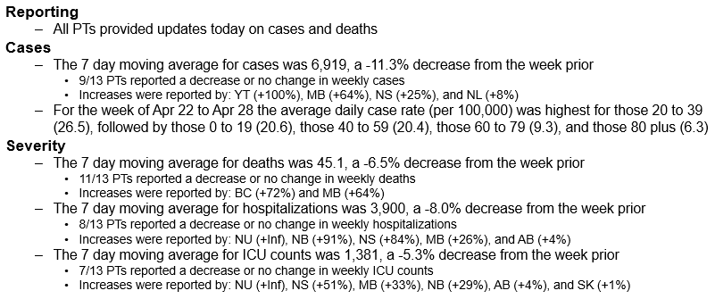
The Solution: Using Base R Functions to Automate Analysis and Messaging
EXAMPLE:
Notes:
R has also reduced the burden of analysis and commentary. Each night, a team of epidemiologists were devoting time to going through the various metrics and analytics, then summarizing the findings, as well as isolating important data points. This analysis was then placed in bullet points or footnotes into the reports. A lot of this is now being automated using simple calculations and base functions like “paste0” in conjunction with R Markdown. Now, providing big picture analysis is automatically done and outliers are automatically detected. With this information, summary sheets are automatically populated. How many provinces reported their data today? Which province saw the largest increase in cases? How about deaths? How has hospitalization changed since the previous day?

Slide 13

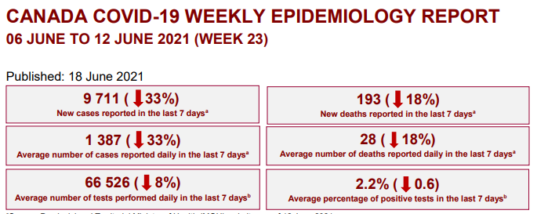
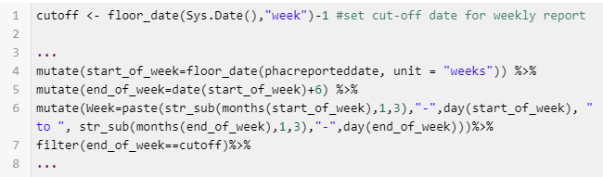
The Solution: Using Lubridate to Handle Report Frequencies
Weekly metrics generated automatically from dynamic database
Define weeks with the help of pre-defined functions (previously done manually in SAS)
Notes:
Packages like lubridate also proved to be very useful. Some metrics and reporting are completed on a weekly basis. With pre-defined functions that have the ability to detect weeks based on a given date, producing these analytics is now smooth and simple. In addition, lubridate functions allow for dynamic titles, headers and footnotes. This has also eliminated the need to manually change macro variables.

Slide 14


The Solution: Building a Package for the Agency
Unifies and simplifies data intake, data processing, outputs, upkeep
Data imports, table generation, figure creation, markdown report written into functions
Allows for uniformity in reporting
Easy access across the agency
Will incorporate more programs and reporting as use of R across agency increases
Notes:
Finally, to incorporate all the work that was done using R, a package has been built for internal agency use. Each data import, table, figure, and markdown report has been written into its own function; these functions comprise the R package. This unifies and simplifies data intake, data processing, outputs and upkeep, and allows all employees to easily access and generate figures. This package also makes maintaining reports more efficient and centralized.
As a result of the efficiencies achieved from using R to conduct reporting, we hope to incorporate additional surveillance products into our package while increasing the use of R across the agency.

Slide 15
THANK YOU!

